Slide 1
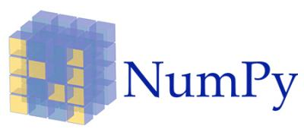
Topic 2
Data Manipulation Using The Numpy Package
Official (Open) Non-Sensitive

Slide 2
Contents
Contents
Intro to Numpy
Creating Numpy arrays
Numpy data types
Inspecting Numpy arrays
Subsetting, Slicing and Indexing Numpy arrays
Copying Arrays
Sorting Arrays
Manipulating Array Shapes
Changing array shape
Transpose array
Add/ remove elements
Combine arrays
Split arrays
Converting arrays
Array Mathematics
Arithmetic operations
Logical operations
Mathematical and Statistical Methods
File I/O on Numpy arrays
Official (Open) Non-Sensitive

Slide 3
Intro to Numpy
Official (Open) Non-Sensitive

Slide 4
What is Numpy?
Introduction to Numpy
NumPy (short for numerical Python) is an open source Python library for scientific computing.
It lets you work with arrays and matrices in a natural way
Contains a long list of useful mathematical functions, including some functions for linear algebra, Fourier transformation, and random number generation routines.
Encapsulates some functionality of MATLAB and Mathematica, allowing rapid interactive prototyping.
Official (Open) Non-Sensitive

Slide 5
History of Numpy
Introduction to Numpy
Based on Numeric which was released in 1995
In 2001, a number of people inspired by Numeric created SciPy, an open source scientific computing Python library that provides functionality similar to that of MATLAB, Maple, and Mathematica
Around this time, people were growing increasingly unhappy with Numeric
In 2005, Travis Oliphant, an early contributor to SciPy rewrote Numeric and NumPy 1.0 was released in 2006
Originally, NumPy code was part of SciPy. It was later separated and is now used by SciPy for array and matrix processing
Official (Open) Non-Sensitive

Slide 6
Why use NumPy?
Introduction to Numpy
NumPy code is much cleaner than regular Python code to accomplish the same tasks. Fewer loops required as operations work directly on arrays and matrices
Has many convenience and mathematical functions that make coding much easier
Underlying algorithms designed with high performance in mind. Large portions of NumPy are written in C. This makes NumPy faster than pure Python code
NumPy's arrays are stored more efficiently than an equivalent data structure in base Python, such as a list of lists. The bigger the array, the more it pays off to use NumPy
Official (Open) Non-Sensitive

Slide 7
A simple application
Introduction to Numpy
Imagine that we want to add two vectors called a and b
a = [0,1,4,9,16...] # The vector a holds the squares of integers 0 to n
b = [0,1,8,27,64...] # The vector b holds the cubes of integers 0 to n
def pythonsum(n):
a = list(range(n))
b = list(range(n))
c = [] for i in range(len(a)):
a[i] = i ** 2
b[i] = i ** 3
c.append(a[i] + b[i])
return c
import numpy as np
def numpysum(n):
a = np.arange(n) ** 2
b = np.arange(n) ** 3
c = a + b
return c
Using base Python
Using NumPy
Official (Open) Non-Sensitive

Slide 8
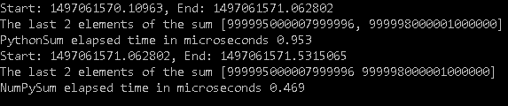
Comparison of run speeds
Introduction to Numpy
Need some convincing that Numpy is indeed more efficient when computing large-sized arrays?
Here's the output of a program that calculates the time needed for each program to compute: n=10000000
Official (Open) Non-Sensitive

Slide 9
Numpy Documentation
Introduction to Numpy
Official documentation
http://docs.scipy.org/doc/
Numpy Tutorial
https://docs.scipy.org/doc/numpy-dev/user/quickstart.html
The NumPy book
http://www.tramy.us/numpybook.pdf
Example list
http://www.scipy.org/Numpy_Example_List_With_Doc
Official (Open) Non-Sensitive

Slide 10
Creating Numpy Arrays
Official (Open) Non-Sensitive

Slide 11
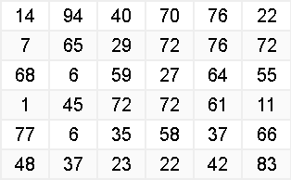
Numpy Array
Introduction to Numpy
NumPy provides an N-dimensional array type, the ndarray, which describes a collection of “items” of the same type
The "type" can be any arbitrary structure of bytes and specified using the data type
import numpy as np
# Create a 2-d array (6x6)
a = np.array([(14,94,40,70,76,22),(7,65,29,72,76,72), (68,6,59,27,64,55),
(1,45,72,72,61,11),(77,6,35,58,37,66),(48,37,23,22,42,83)],
dtype=np.int32)
print(a[1,1]) # Prints Row 1, Col 1 : 65
print(a[3]) # Prints Row 3, all columns [ 1 45 72 72 61 11]
Official (Open) Non-Sensitive

Slide 12
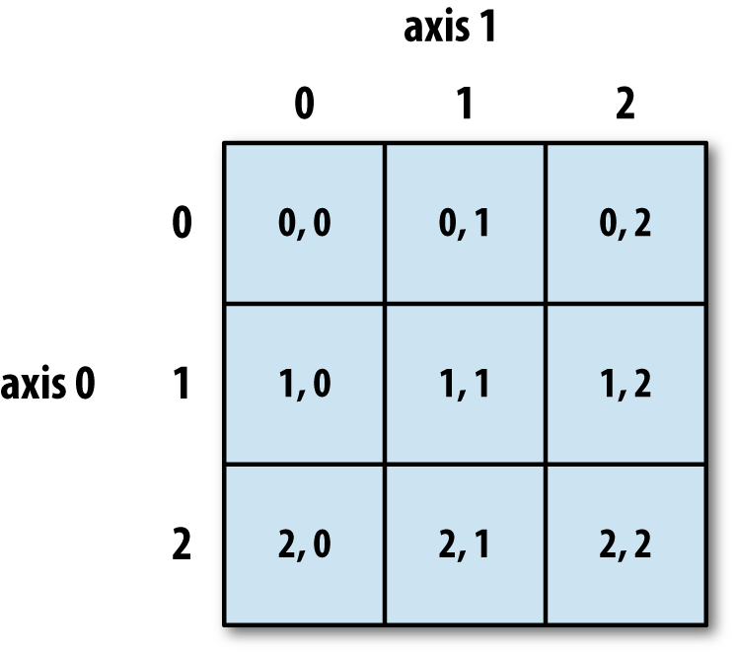
Structure of ndarray
Introduction to Numpy
This is an example of a 3x3 ndarray
The size of the array is 9 (i.e. 9 elements inside) and the dimension is 2 (i.e. 2D array)
Official (Open) Non-Sensitive

Slide 13
Using .array() method
Creating Numpy Arrays
import numpy as np
a = np.array([1,2,3]) # Create a 1-d array of integers
b = np.array([(1,2,3),(4,5,6)]) # Create a 2-d array (2x3)
# Create a 2-d array (2x4) of type float
c = np.array([(1.5,2.5,3.5,4.5),(5.5,6.5,7.5,8.5)],dtype=float)
# Create a 1-d array of strings e = np.array(['Apple', 'Orange', 'Pear', 'Durian'])
# Create a 1-d array of datetime objectws e = np.array(['2017-01-01', '2017-01-02', '2017-01-03'], dtype='datetime64')
Official (Open) Non-Sensitive

Slide 14

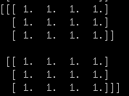
Using zeros() and ones()
Creating Numpy Arrays
import numpy as np
# Create a 3x4 2-d array, with initial value zero
a = np.zeros((3,4))
print(a)
# Create a 2x3x4 3-d array with initial value one
b = np.ones((2,3,4))
print(b)
Official (Open) Non-Sensitive

Slide 15

Using arange()
Creating Numpy Arrays
import numpy as np
# numpy.arange(start,stop,step)
# Create an array that starts from zero and ends at 8
a = np.arange(0,9)
print(a)
# Create array that starts from 10 and ends at 19 with interval 2
c = np.arange(10,20,2)
print(c)
Official (Open) Non-Sensitive
Notes:
https://docs.scipy.org/doc/numpy/reference/generated/numpy.arange.html

Slide 16
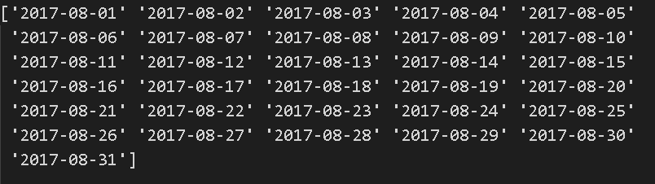
Using arange()
Creating Numpy Arrays
import numpy as np
# Create an array that contains the dates in month of Aug 2017
d = np.arange('2017-08-01','2017-09-01',dtype='datetime64')
print(d)
Official (Open) Non-Sensitive
Notes:
https://docs.scipy.org/doc/numpy/reference/generated/numpy.arange.html

Slide 17
Using linspace()
Creating Numpy Arrays
import numpy as np
# numpy.linspace(start,stop,num)
# Create array that starts with 0 and ends at 2 # with 9 samples in between
d = np.linspace(0,2,9)
print(d)
Official (Open) Non-Sensitive
Notes:
https://docs.scipy.org/doc/numpy/reference/generated/numpy.linspace.html

Slide 18


Using full() and eye()
Creating Numpy Arrays
import numpy as np
# Create a constant array with a specified value # numpy.full(shape, fill_value)
e = np.full((2,2),7)
print(e)
# Create a 2x2 identity matrix
f = np.eye(2)
print(f)
Official (Open) Non-Sensitive
Notes:
https://docs.scipy.org/doc/numpy/reference/generated/numpy.full.html
https://docs.scipy.org/doc/numpy/reference/generated/numpy.eye.html

Slide 19

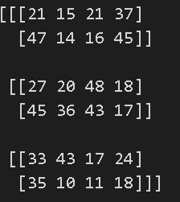
Using random() and randint()
Creating Numpy Arrays
import numpy as np
# Create a 2x2 array with random floats in the interval 0.0 to 1.0 g = np.random.random((2,2))
print(g)
# Create a 3x2x4 array with random numbers # between 10 and 50 (not including 50)
h = np.random.randint(10,50,(3,2,4))
print(h)
Official (Open) Non-Sensitive
Notes:
https://docs.scipy.org/doc/numpy/reference/generated/numpy.random.random.html
https://docs.scipy.org/doc/numpy/reference/generated/numpy.random.randint.html

Slide 20

Using empty()
Creating Numpy Arrays
import numpy as np
# Create a 3x2 empty array
h = np.empty((3,2))
print(h)
Official (Open) Non-Sensitive
Notes:
https://docs.scipy.org/doc/numpy/reference/generated/numpy.empty.html

Slide 21
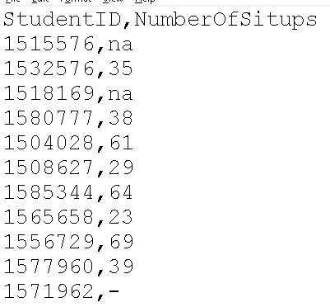

Using loadtxt()
Creating Numpy Arrays
Load data from a text file
Each row in the text file must have the same number of values.
import numpy as np
d = np.loadtxt("data/situps.csv",
delimiter=',',skiprows=1,
dtype=[('StudentID','u8'),('NumberOfSitups','i8')])
print(d)
print(d.shape)
Official (Open) Non-Sensitive
Notes:
https://docs.scipy.org/doc/numpy-1.13.0/reference/generated/numpy.loadtxt.html

Slide 22
Using genfromtxt()
Creating Numpy Arrays
Load data from a text file, with missing values handled as specified.
Each line past the first skip_header lines is split at the delimiter character, and characters following the comments character are discarded.
import numpy as np
d = np.genfromtxt("data/situps.csv",
delimiter=',',skip_header=1,
dtype=[('StudentID','u8'),('NumberOfSitups','i8')], missing_values=['na','-'],filling_values=0)
print(d)
print(d.shape)
Official (Open) Non-Sensitive
Notes:
https://docs.scipy.org/doc/numpy-1.13.0/reference/generated/numpy.genfromtxt.html#numpy.genfromtxt

Slide 23
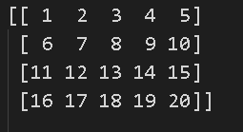
Using reshape()
Creating Numpy Arrays
import numpy as np
# Create 20 numbers from 1 to 20 as a 1-d array
# then reshape this to a 2d array of shape 4x5
a = np.arange(1,21).reshape(4,5)
print(a)
Official (Open) Non-Sensitive

Slide 24
Put different ndarrays into 1 single ndarray
Creating Numpy Arrays
import numpy as np
c1 = np.array([1,2,3,4,5])
c2 = np.arange(2,21,2)
c3 = np.random.randint(1,100,10)
c = np.array([c1,c2,c3])
Official (Open) Non-Sensitive

Slide 25
Numpy Data Types
Official (Open) Non-Sensitive
Notes:
https://docs.scipy.org/doc/numpy/reference/arrays.dtypes.html

Slide 26
Numpy Data Types
Data Types
np.int32 | 32-bit integer
np.int64 | 64-bit integer
np.float64 | 64-bit decimal number
np.bool | Boolean type storing TRUE and FALSE values
np.object | Python object type
np.unicode | Fixed-length Unicode string type
Official (Open) Non-Sensitive

Slide 27
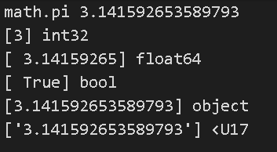
Numpy Data Types
Data Types
import numpy as np
import math
a = np.array([math.pi],dtype=np.int32)
b = np.array([math.pi],dtype=np.float64)
c = np.array([math.pi],dtype=np.bool)
d = np.array([math.pi],dtype=np.object)
e = np.array([math.pi],dtype=np.unicode)
Official (Open) Non-Sensitive

Slide 28
Inspecting your array
Official (Open) Non-Sensitive

Slide 29

shape
Inspecting your array
import numpy as np
# Create 3 arrays with different shapes
a = np.array([1,2,3])
b = np.array([(1,2,3),(4,5,6)])
c = np.array([[(1,2,3,4),(5,6,7,8)], [(9,10,11,12),(13,14,15,16)]])
print(a.shape)
print(b.shape)
print(c.shape)
Official (Open) Non-Sensitive

Slide 30
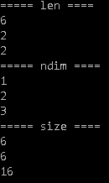
len, ndim, size
Inspecting your array
import numpy as np
# Create 3 arrays with different shapes and sizes
a = np.array([1,2,3,4,5,6])
b = np.array([(1,2,3),(4,5,6)])
c = np.array([[(1,2,3,4),(5,6,7,8)], [(9,10,11,12),(13,14,15,16)]])
# Number of rows
print(len(a));print(len(b));print(len(c))
# Number of dimensions
print(a.ndim);print(b.ndim);print(c.ndim)
# Total number of elements across dimensions
print(a.size);print(b.size); print(c.size)
Official (Open) Non-Sensitive

Slide 31
Subsetting, Slicing and Indexing
Official (Open) Non-Sensitive

Slide 32
Slicing and indexing (1-d array)
Subsetting, Slicing and Indexing
import numpy as np
a = np.arange(9) # a = [0,1,2,3,4,5,6,7,8]
# Select the element at index 2
print(a[2]) # 2
# Select elements from index 0 to 7 with step 2
print(a[:7:2]) # 0 2 4 6
# Select and reverse elements from index 0 to the end
print(a[::-1]) # 8 7 6 5 4 3 2 1
Official (Open) Non-Sensitive

Slide 33
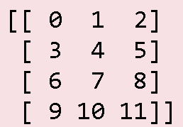
Slicing and indexing (2-d array)
Subsetting, Slicing and Indexing
import numpy as np
# Create an array with 0 to 12 and reshape it into a 4x3 array b = np.arange(12).reshape(4,3)
#print(b)
#print(b[2]) # print row 3 only
#print(b[1:3]) # print rows 2 and 3, all columns
#print(b[:,2]) # print all rows, column 3 only
print(b[1:,:3]) # print rows 2 till the end, all columns
### These examples show how to slice a 2d array
Official (Open) Non-Sensitive

Slide 34
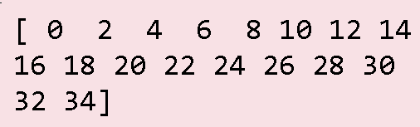
Boolean Indexing
Subsetting, Slicing and Indexing
Boolean indexing lets you indicate if an element should be included
In the example below, we want to create an array with only the even numbers
import numpy as np
a = np.arange(36).reshape(6,6)
# Use boolean indexing to # get even numbers only
b = a % 2 == 0
a = a[b]
print(a)
Official (Open) Non-Sensitive

Slide 35
Copying arrays
Official (Open) Non-Sensitive

Slide 36

numpy.copy
Copying Arrays
import numpy as np
# Create 2 arrays with different data types, shapes and sizes
a = np.array([10,2,8,4,6,1,5,9,3,7]) b = np.array([("Red","Blue","Yellow"),("Green","Cyan","Magenta")])
npc = np.copy(a)
npc.sort()
print(a)
print(npc)
Official (Open) Non-Sensitive

Slide 37
Sorting arrays
Official (Open) Non-Sensitive

Slide 38

Sorting arrays
Sorting Arrays
import numpy as np
# Create 2 arrays with different data types, shapes and sizes
a = np.array([10,2,8,4,6,1,5,9,3,7]) b = np.array([("Red","Blue","Yellow"),("Green","Cyan","Magenta")])
a.sort()
b.sort(axis=1)
print(a)
print(b)
Official (Open) Non-Sensitive
Notes:
https://docs.scipy.org/doc/numpy/reference/generated/numpy.full.html
https://docs.scipy.org/doc/numpy/reference/generated/numpy.eye.html

Slide 39
Functions to manipulate array shapes
Manipulating Array Shapes
CHANGE ARRAY SHAPE
flatten()
reshape()
shape()
resize()
COMBINE ARRAYS
concatenate
ADD/REMOVE ELEMENTS
append()
insert()
delete()
TRANSPOSE ARRAY
transpose
Official (Open) Non-Sensitive

Slide 40
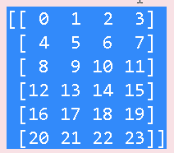
Change array shape - flatten()
Manipulating Array Shapes
Use this function to convert your M-D array to a 1-D array
Return value is a copy of the original array
import numpy as np
b = np.arange(24).reshape(6,4)
c = b.flatten()
print("\n**Before**")
print(b) #[ 0 1 2 3 4 5 6 7 8 9 10 11 12 13 14 15 16 17 18 19 20 21 22 23]
print(c) #[ 0 1 2 3 4 5 6 7 8 9 10 11 12 13 14 15 16 17 18 19 20 21 22 23]
print("\n**After**")
c[0] = 100; # change the first value in the copy
print(b)
print(c) ]
Official (Open) Non-Sensitive

Slide 41
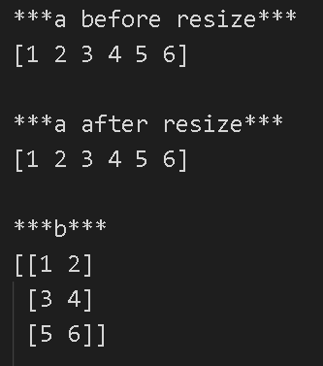
Change array shape - reshape()
Manipulating Array Shapes
reshape gives a new shape to an array without changing its data. It creates a new array and does not modify the original array itself
import numpy as np
a = np.array([1,2,3,4,5,6])
print("***a before resize***");print(a);print()
b = a.reshape(3,2)
print("***a after resize***");print(a);print()
print("***b***");print(b);print()
Note - alternative way to do reshape
b = np.reshape(a,(3,2))
Official (Open) Non-Sensitive

Slide 42
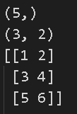
shape
Manipulating Array Shapes
The shape attribute an be used to get array dimensions or to change array dimensions
import numpy as np
a= np.array([1, 2, 3, 4, 5])
print(a.shape) #(5,) -> 5 rows and 0 columns
b = np.array([[1, 2],[3, 4],[6,5]])
print(b.shape) #(3, 2) -> 3 rows and 2 columns
# Change the shape of the array
c = np.array([1,2,3,4,5,6])
c.shape = (3, 2)
print(c)
Official (Open) Non-Sensitive

Slide 43
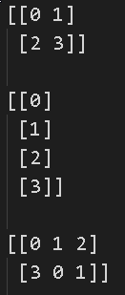
resize()
Manipulating Array Shapes
The resize() method works just like the reshape() function, but modifies the array it operates on:
import numpy as np
a=np.array([[0,1],[2,3]]) #2x2
print("***a before resize***");print(a);print()
a.resize(4,1)
print("***a after resize first time***");print(a);print()
a.resize(2,3)
print("***a after resize second time***");print(a);print()
Official (Open) Non-Sensitive

Slide 44
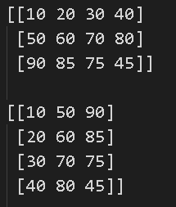
transpose()
Manipulating Array Shapes
The transpose of an array can be obtained by using transpose() method
transpose() is both a library level function and an instance method.
It can be called as numpy.transpose(ndarray) or numpy.ndarray.transpose().
ndarray has an attribute named ‘T’, which returns the transpose of the array.
import numpy as np
x = np.array(([10,20,30,40], [50,60,70,80], [90, 85, 75, 45]))
print(x)
print(x.transpose())
print(np.transpose(x))
print(x.T)
Official (Open) Non-Sensitive

Slide 45

concatenate() - 1-d arrays
Manipulating Array Shapes
Two or more arrays can be concatenated using concatenate() function along an axis
The arrays must have the same shape, except in the dimension corresponding to axis (the first, by default).
numpy.concatenate((a1, a2, ...), axis=0)
import numpy as np
# 1-D array
x = np.arange(5)
y = np.arange(6,10)
z = np.arange(11,15)
print(x);print(y); print(z)
print(np.concatenate((x,y,z)))
Official (Open) Non-Sensitive
Notes:
https://docs.scipy.org/doc/numpy-1.13.0/reference/generated/numpy.concatenate.html

Slide 46
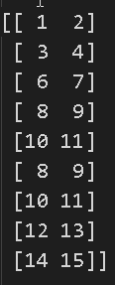

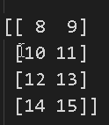
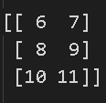
concatenate() 2-d arrays on axis=0
Manipulating Array Shapes
import numpy as np
# Reshaped to 2-D
x = np.arange(1,5).reshape(2,2)
y = np.arange(6,12).reshape(3,2)
z = np.arange(8,16).reshape(4,2)
print(x)
print(y)
print(z)
print(np.concatenate((x,y,z)))
Official (Open) Non-Sensitive
Notes:
https://docs.scipy.org/doc/numpy-1.13.0/reference/generated/numpy.concatenate.html

Slide 47
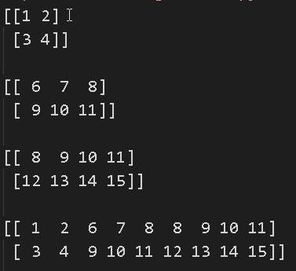
concatenate() - 2-d arrays on axis=1
Manipulating Array Shapes
import numpy as np
x = np.arange(1,5).reshape(2,2)
y = np.arange(6,12).reshape(2,3)
z = np.arange(8,16).reshape(2,4)
print(x)
print(y)
print(z)
print(np.concatenate((x,y,z),axis=1))
Official (Open) Non-Sensitive
Notes:
https://docs.scipy.org/doc/numpy-1.13.0/reference/generated/numpy.concatenate.html

Slide 48

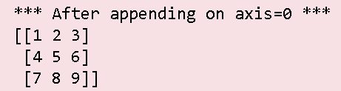

append()
Manipulating Array Shapes
Append values to the end of an array
values must be same shape as arr
If axis not specified, values can be any shape and flattened
numpy.append(arr, values, axis=None)
import numpy as np
a = np.array([(1,2,3), (4,5,6)])
b= np.append(a, np.array([(7,8,9)]),axis = 0)
c = np.append(a, np.array([(7,8), (9,10)]),axis = 1)
Official (Open) Non-Sensitive
Notes:
https://docs.scipy.org/doc/numpy-1.13.0/reference/generated/numpy.append.html

Slide 49
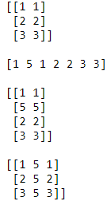
insert()
Manipulating Array Shapes
numpy.insert(arr, obj, values, axis=None)
Insert values along the given axis before the given indices.
import numpy as np
a = np.array([[1, 1], [2, 2], [3, 3]])
print(a);print()
print(np.insert(a, 1, 5)) # array is flattened
print()
print(np.insert(a, 1, 5, axis = 0))
print()
print(np.insert(a, 1, 5, axis = 1))
Official (Open) Non-Sensitive
Notes:
https://docs.scipy.org/doc/numpy-1.13.0/reference/generated/numpy.insert.html

Slide 50
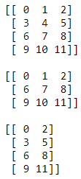
delete()
Manipulating Array Shapes
numpy.delete(arr, obj, axis=None)
Return a new array with sub-arrays along an axis deleted. For a one dimensional array, this returns those entries not returned by arr[obj].
import numpy as np
arr = np.arange(12).reshape(4,3)
print(arr)
print()
print(np.delete(arr, 1, 0))
print()
print(np.delete(arr, 1, 1))
Official (Open) Non-Sensitive
Notes:
https://docs.scipy.org/doc/numpy-1.13.0/reference/generated/numpy.delete.html#numpy.delete

Slide 51
Functions to split arrays
Splitting arrays
split() | This function stacks one-dimensional arrays as columns to create a two-dimensional array
hsplit() | This function stacks arrays vertically
vsplit() | This function stacks arrays depth-wise along the third axis
Official (Open) Non-Sensitive

Slide 52
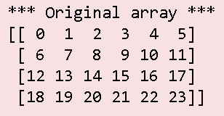
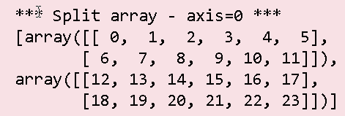
split
Splitting arrays
numpy.split(array, indices_or_sections, axis=0)
Split an array into multiple sub-arrays.
import numpy as np
a = np.arange(24).reshape(4,6)
b = np.split(a, 2, axis=0)
c = np.split(a, 3, axis=1)
Official (Open) Non-Sensitive
Notes:
https://docs.scipy.org/doc/numpy-1.15.1/reference/generated/numpy.split.html

Slide 53
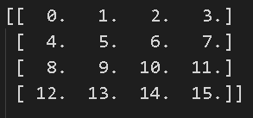
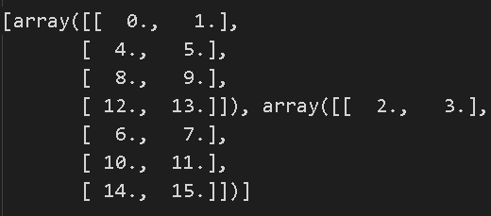
hsplit
Splitting arrays
Split an array into multiple sub-arrays horizontally (column-wise)
Equivalent to split with axis=1, the array is always split along the second axis regardless of the array dimension
import numpy as np
x = np.arange(16.0).reshape(4, 4)
y = np.hsplit(x, 2)
print(x)
print(y)
Official (Open) Non-Sensitive
Notes:
https://docs.scipy.org/doc/numpy-1.13.0/reference/generated/numpy.hsplit.html

Slide 54
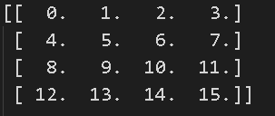
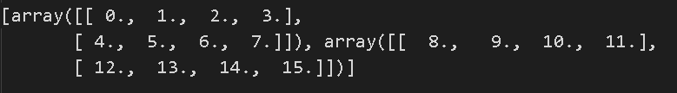
vsplit
Splitting arrays
Split an array into multiple sub-arrays vertically (row-wise)
equivalent to split with axis=0 (default), the array is always split along the first axis regardless of the array dimension
import numpy as np
x = np.arange(16.0).reshape(4, 4)
y = np.vsplit(x, 2)
print(x)
print(y)
Official (Open) Non-Sensitive
Notes:
https://docs.scipy.org/doc/numpy-1.13.0/reference/generated/numpy.vsplit.html

Slide 55
Functions to convert arrays
Converting arrays
tolist() | Return the array as a Python list.
astype() | Return a copy of the array, cast to a specified type
Official (Open) Non-Sensitive
Notes:
https://docs.scipy.org/doc/numpy-1.14.0/reference/generated/numpy.ndarray.tolist.html

Slide 56

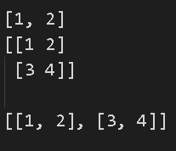
tolist()
Converting arrays
Return a copy of the array data as a (nested) Python list.
Data items are converted to the nearest compatible Python type.
import numpy as np
a = np.array([1, 2])
print(a)
print()
print(a.tolist())
b = np.array([[1, 2], [3, 4]])
print(b)
print()
print(b.tolist())
Official (Open) Non-Sensitive
Notes:
https://docs.scipy.org/doc/numpy/reference/generated/numpy.ndarray.tolist.html

Slide 57

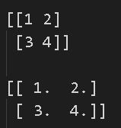
astype()
Converting arrays
Copy of the array, cast to a specified type
import numpy as np
a = np.array([1, 2])
print(a)
print()
print(a.astype(int))
b = np.array([[1, 2], [3, 4]])
print(b)
print()
print(b.astype(float))
Official (Open) Non-Sensitive
Notes:
https://docs.scipy.org/doc/numpy/reference/generated/numpy.ndarray.astype.html

Slide 58
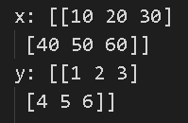



Arithmetic operators
Arithmetic and Logical operations on Arrays
The standard arithmetic operators such as: +, -, *, /, **, % are applied on individual elements, so, the arrays have to be of the same size
import numpy as np
x = np.array(([10,20,30], [40,50,60]))
y = np.array(([1,2,3], [4,5,6]))
print(x) print(y)
print(x+y)
print(x-y)
print(x*y)
print(x/y)
print(x%y)
Official (Open) Non-Sensitive

Slide 59
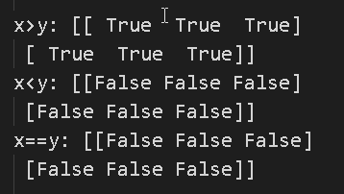
Logical operators
Arithmetic and Logical operations on Arrays
Similarly, logical operators >, < , == are applied on individual elements, so arrays have to be of same size
import numpy as np
x = np.array(([10,20,30], [40,50,60]))
y = np.array(([1,2,3], [4,5,6]))
print(x) print(y)
print(x>y)
print(x<y)
print(x==y)
Official (Open) Non-Sensitive

Slide 60
Mathematical and Statistical Methods
Mathematical and Statistical Methods
sum() | Sum of all the elements in the array or along an axis. Zero-length arrays have sum 0.
mean() | Arithmetic mean. Zero-length arrays have NaN mean.
median()
cumsum() | Return the cumulative sum of the elements along a given axis.
cumprod() | This function stacks one-dimensional arrays as columns to create a two-dimensional array
std, var | Returns the standard deviation, a measure of the spread of a distribution, of the array elements Returns the variance of the array elements, a measure of the spread of a distribution
min,max | Return the minimum, maximum along a given axis
argmin, argmax | Return indices of the minimum, maximum values along the given axis
Official (Open) Non-Sensitive

Slide 61
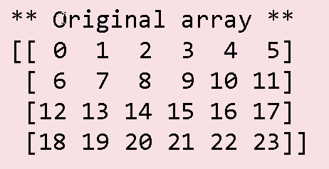
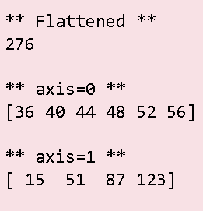
sum()
Mathematical and Statistical Methods
Sum of all the elements in the array or along an axis
Zero-length arrays have sum 0
numpy.sum(a, axis=None, dtype=None, out=None, keepdims=False)
import numpy as np
a = np.arange(24).reshape(4,6)
print("** Original array **")
print(a)
print()
b = a.sum()
c = a.sum(axis=0)
d = a.sum(axis=1)
Official (Open) Non-Sensitive
Notes:
https://docs.scipy.org/doc/numpy-1.14.0/reference/generated/numpy.sum.html

Slide 62
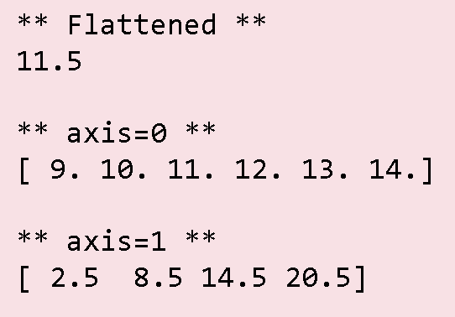
mean()
Mathematical and Statistical Methods
Sum of all the elements in the array or along an axis
Zero-length arrays have sum 0
numpy.mean(a, axis=None, dtype=None, out=None, keepdims=False)
import numpy as np
a = np.arange(24).reshape(4,6)
print("** Original array **")
print(a)
print()
b = a.mean()
c = a.mean(axis=0)
d = a.mean(axis=1)
Official (Open) Non-Sensitive
Notes:
https://docs.scipy.org/doc/numpy-1.15.1/reference/generated/numpy.mean.html

Slide 63
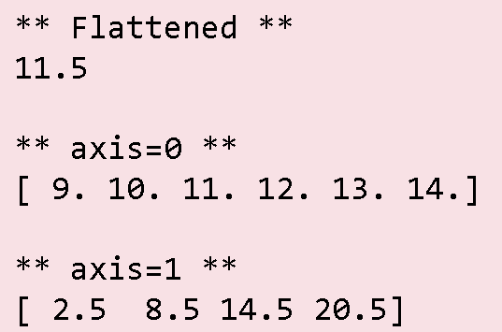
median()
Mathematical and Statistical Methods
Compute the median along the specified axis.
Returns the median of the array elements
numpy.median(a, axis=None, out=None, overwrite_input=False, keepdims=False)
import numpy as np
a = np.arange(24).reshape(4,6)
print("** Original array **")
print(a)
print()
b = np.median(a)
c = np.median(a,axis=0)
d = np.median(a,axis=1)
Official (Open) Non-Sensitive
Notes:
https://docs.scipy.org/doc/numpy-1.13.0/reference/generated/numpy.median.html

Slide 64
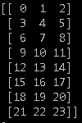
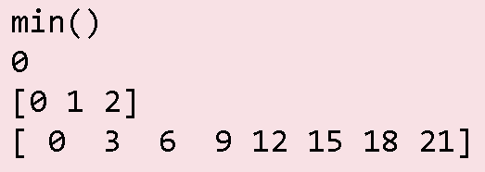
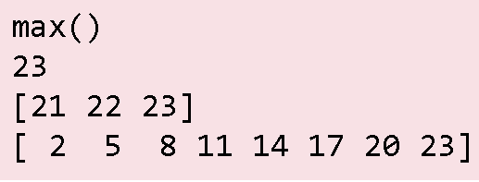
min(), max()
Mathematical and Statistical Methods
Return the minimum/max along a given axis
ndarray.min(axis=None, out=None, keepdims=False)
ndarray.max(axis=None, out=None, keepdims=False)
import numpy as np
b = np.arange(24).reshape(8,3)
print(b.min())
print(b.min(axis=0))
print(b.min(axis=1))
print(b.max())
print(b.max(axis=0))
print(b.max(axis=1))
Official (Open) Non-Sensitive
Notes:
https://docs.scipy.org/doc/numpy-1.14.0/reference/generated/numpy.ndarray.min.html
https://docs.scipy.org/doc/numpy-1.14.0/reference/generated/numpy.ndarray.max.html

Slide 65
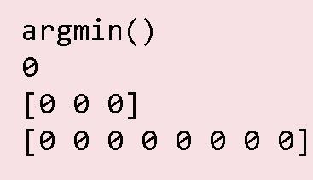
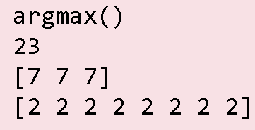
argmin(), argmax()
Mathematical and Statistical Methods
Returns the indices of the minimum values along an axis.
numpy.argmin(a, axis=None, out=None)
numpy.argmax(a,axis=None, out=None)
import numpy as np
b = np.arange(24).reshape(8,3)
print(b)
print(b.argmin())
print(b.argmin(axis=0))
print(b.argmin(axis=1))
print(b.argmax())
print(b.argmax(axis=0))
print(b.argmax(axis=1))
Official (Open) Non-Sensitive
Notes:
https://docs.scipy.org/doc/numpy-1.15.0/reference/generated/numpy.argmin.html
https://docs.scipy.org/doc/numpy-1.15.1/reference/generated/numpy.argmax.html

Slide 66




cumsum()
Mathematical and Statistical Methods
Return the cumulative sum of the elements along a given axis
numpy.cumsum(a, axis=None, dtype=None, out=None)
import numpy as np
a = np.array([[1,2,3], [4,5,6]])
print(a)
b = np.cumsum(a)
print(b)
c = np.cumsum(a,axis=0)
print(c)
d = np.cumsum(a,axis=1)
print(d)
Official (Open) Non-Sensitive
Notes:
https://docs.scipy.org/doc/numpy-1.15.1/reference/generated/numpy.cumsum.html

Slide 67



cumprod()
Mathematical and Statistical Methods
Return the cumulative product of the elements along a given axis
numpy.cumprod(a, axis=None, dtype=None, out=None)
import numpy as np
a = np.array([[1,2,3], [4,5,6]])
print(a)
b = np.cumprod(a)
print(b) # [ 1 2 6 24 120 720]
c = np.cumprod(a,axis=0)
print(c)
d = np.cumprod(a,axis=1)
print(d)
Official (Open) Non-Sensitive
Notes:
https://docs.scipy.org/doc/numpy-1.15.1/reference/generated/numpy.cumprod.html

Slide 68
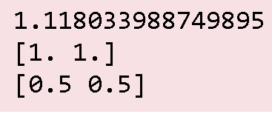
std()
Mathematical and Statistical Methods
Compute the standard deviation along the specified axis
numpy.stdnumpy.std(a, axis=None,dtype=None,out=None)
import numpy as np
a = np.array([[1, 2], [3, 4]])
v1 = np.std(a,dtype=np.float64)
v2 = np.std(a, axis=0,dtype=np.float64)
v3 = np.std(a, axis=1,dtype=np.float64)
print(v1)
print(v2)
print(v3)
Official (Open) Non-Sensitive
Notes:
https://docs.scipy.org/doc/numpy-1.13.0/reference/generated/numpy.std.html

Slide 69
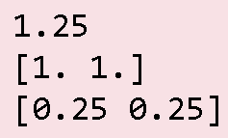
var()
Mathematical and Statistical Methods
Compute the variance along the specified axis
numpy.var(a, axis=None, dtype=None, out=None, ddof=0)
import numpy as np
a = np.array([[1, 2], [3, 4]])
v1 = np.var(a,dtype=np.float64)
v2 = np.var(a, axis=0,dtype=np.float64)
v3 = np.var(a, axis=1,dtype=np.float64)
print(v1)
print(v2)
print(v3)
Official (Open) Non-Sensitive
Notes:
https://docs.scipy.org/doc/numpy-1.15.1/reference/generated/numpy.var.html
numpy.var(a, axis=None, dtype=None, out=None, ddof=0, keepdims=<no value>)
Compute the variance along the specified axis.
Returns the variance of the array elements, a measure of the spread of a distribution.
The variance is computed for the flattened array by default, otherwise over the specified axis.
https://www.mathsisfun.com/data/standard-deviation.html

Slide 70
File Input and Output with Arrays
File Input and Output with Arrays
NumPy is able to save and load data in both text and binary format
Function | Description
load() | Load a Numpy array from disk
save() | Save a Numpy array to a binary file
savez() | Save several arrays into a single file in uncompressed .npz format.
Function | Description
loadtxt(filename) | Load data from a text file. Each row in the text file must have the same number of values.
genfromtxt(filename) | Load data from a text file, with missing values handled as specified.
savetxt(filename) | Save an array to a text file.
Official (Open) Non-Sensitive
Notes:
https://docs.scipy.org/doc/numpy/reference/generated/numpy.save.html
https://docs.scipy.org/doc/numpy/reference/generated/numpy.savez.html
https://docs.scipy.org/doc/numpy/reference/generated/numpy.load.html
https://docs.scipy.org/doc/numpy/reference/generated/numpy.loadtxt.html
https://docs.scipy.org/doc/numpy/reference/generated/numpy.genfromtxt.html
https://docs.scipy.org/doc/numpy/reference/generated/numpy.savetxt.html

Slide 71
save(), savez()
File Input and Output with Arrays
The np.save() method for saving a single array as binary format
import numpy as np
arr = np.arange(10)
np.save('myarray.npy', arr)
The np.savez() method for saving multiple arrays to a ZIP file
import numpy as np
a = np.arange(10)
b = np.arange(20).reshape(2,10)
np.savez('array_archive.npz', a=a, b=b)
Official (Open) Non-Sensitive

Slide 72
load()
File Input and Output with Arrays
The np.load() method for reading a single array file
import numpy as np
arr = np.load('myarray.npy')
print(arr)
The np.load() method for reading a zip file containing multiple arrays
import numpy as np
arch = np.load('array_archive.npz')
print(arch['a'])
print(arch['b'])
Official (Open) Non-Sensitive
Notes:
https://docs.scipy.org/doc/numpy-1.15.0/reference/generated/numpy.load.html
numpy.load(file, mmap_mode=None, allow_pickle=True, fix_imports=True, encoding='ASCII')

Slide 73
savetxt()
File Input and Output with Arrays
The np.savetxt() method for saving arrays to a text file
import numpy as np
x = y = z = np.arange(0,5,1)
# save single array using defaults
np.savetxt('test1.txt', x) # X is an array
# save single array ensuring output is formatted as 0 decimal places
np.savetxt('test2.txt', x, fmt='%.0f')
# save multiple arrays, using comma as separator np.savetxt('test3.txt', (x,y,z) , fmt='%.2f', delimiter=",")
Official (Open) Non-Sensitive

Slide 74
End of Topic 2
Official (Open) Non-Sensitive

